Slide 1
Machine Learning
Presented By
Dr. Md. Zahid Hasan
Associate Professor, CSE, DIU

Slide 2
Linear Regression vs Classification Problem
Email is spam or not?
Will customer buy life insurance?
Which party a person is going to vote for?
Democratic
Republican or
Independent
Predicted Value is Categorical
Home Prices
Weather
Stock Price
Predicted Value is Continuous

Slide 3
Logistic Regression?
Logistic Regression is one of the techniques used for classification

Slide 4
Classification Types
Binary Classification | Multi Class Classification
Will customer Open credit card? Yes or No | Which party a person is going to vote for? Democratic Republican or Independent

Slide 5
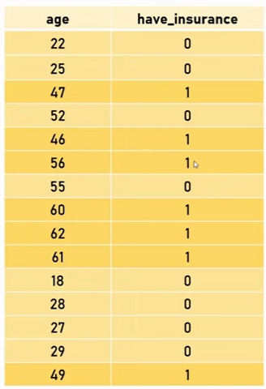
Dataset

Slide 6
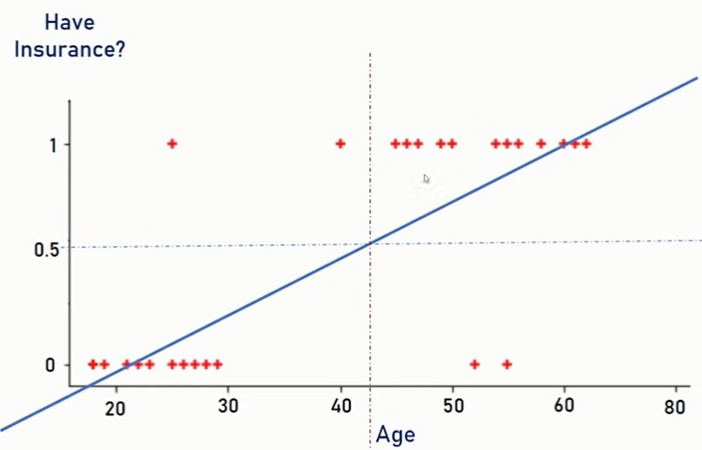
Linear Regression Line

Slide 7
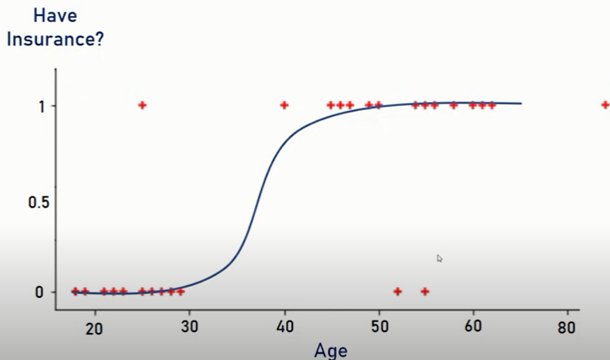
Sigmoid or Logit Function

Slide 8
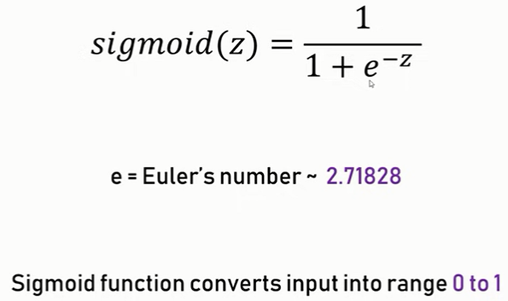
Sigmoid Function

Slide 9
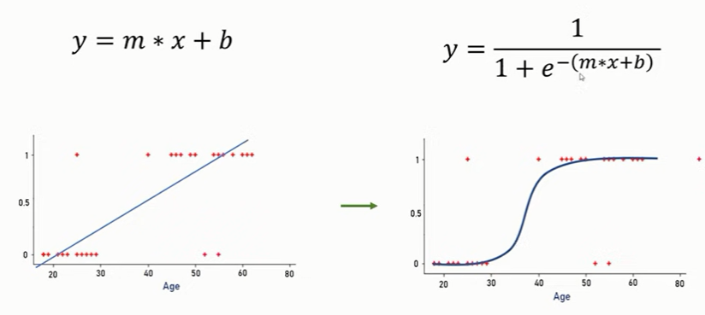
Linear vs Sigmoid

Slide 10
Implementation
import pandas as pd
from matplotlib import pyplot as plt
df = pd.read_csv("/content/drive/MyDrive/Summer 2022/MSC/Logistic_Regression/insurance_data.csv")
df.head()

Slide 11
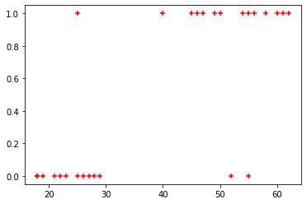
Implementation
plt.scatter(df.age,df.bought_insurance,marker='+',color='red')

Slide 12
Apply Logistic Regression Algorithm
from sklearn.model_selection import train_test_split
X_train, X_test, y_train, y_test = train_test_split(df[['age']],df.bought_insurance,train_size=0.8)
from sklearn.linear_model import LogisticRegression
model = LogisticRegression()
model.fit(X_train, y_train)
y_predicted = model.predict(X_test)
model.score(X_test,y_test)

Slide 13
Thank You

